Slide 1
ISO 55001 Requirements for Asset Management
Quick Overview

Slide 2
Introduction
ISO 55000 gives those responsible for organisational governance and management an appreciation of why the organisation should embrace AM. It highlights that effective acquisition, control and governance of assets by organisations is essential to realising value through managing risk and opportunity to achieve the desired balance of benefits, costs, risk and performance.
It enunciates the benefits of AM and an AM system in providing a structured approach and more reliable decision making for the development, coordination and control of activities undertaken on assets, and for aligning these activities with its organisational objectives.

Slide 3
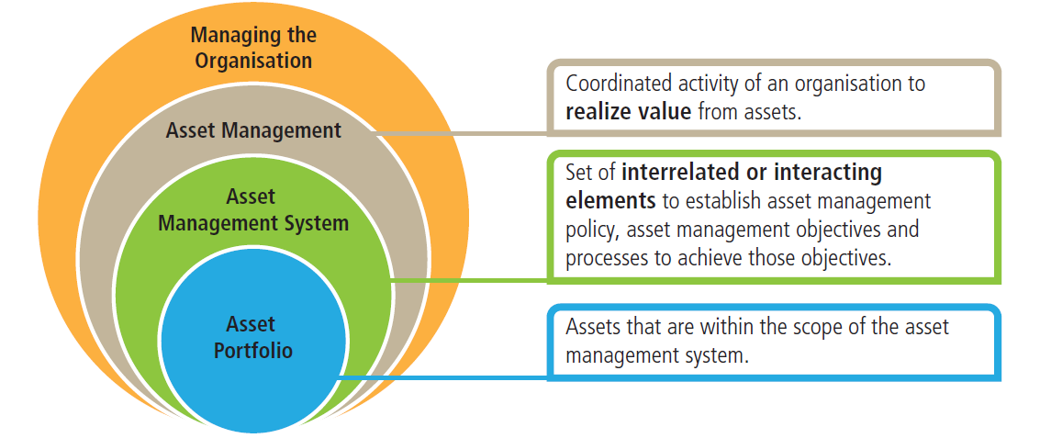
Introduction
ISO 55000 enunciates the benefits of AM and an AM system in providing a structured approach and more reliable decision making for the development, coordination and control of activities undertaken on assets, and for aligning these activities with its organisational objectives.
The following figure shows the typical relationship between AM and the AM system.

Slide 4
Introduction
ISO 55001 is the most critical Standard in that it details the things required to be done - some 70 requirements with a number of sub elements.
It provides a systematic management specification while allowing organisations to structure their activities to suit their needs, resources, capabilities and objectives.

Slide 5
Introduction
The structure of the Standard is:
Context of the Organisation
• Needs/Expectations of Stakeholders
• Scope of the AM system and to which assets it will apply.
Leadership and Commitment
• Policy, Roles, responsibilities and authorities
Planning
• Risks and Opportunities
• AM Objectives and planning to achieve them
Support
• Resources, awareness, competence
• Communication
• Information
Operation and Control
• Change management
• Outsourcing
Performance Evaluation
• Monitoring and Review
• Auditing
Improvement
• Nonconformity
• Corrective and Preventive Action
• Continual improvement

Slide 6
Why use the standard
organisations will implement these Standards to address a range of business objectives including the following (in no particular order):
improved financial performance;
better informed asset investment decisions;
better managed risk;
improved services and outputs;
demonstrated social responsibility;
demonstrated compliance;
enhanced reputation;
improved organisational sustainability; and
improved efficiency and effectiveness.

Slide 7
Why use the standard
ISO state that the main aim of Standards is to promote good practice rather than primarily being about compliance. The Standards themselves do not carry any force to require their application and in most cases it will be up to the organisation to choose to apply them as part of good business practice.
However, in some highly regulated areas involving significant asset values, the regulators, financiers or insurers may require these Standards to be applied, in order to provide evidence the assets are being effectively managed.

Slide 8
International Infrastructure Management Manual
ISO 55001 spells out the requirements for the establishment, implementation, maintenance and improvement of a management system for AM. It specifies ‘what’ an organisation needs to do to fulfil the Standards requirements.
However ISO 55001 does not provide specific direction on ‘how’ an organisation should go about achieving those requirements, nor does it contain asset-specific guidance.
The IIMM complements the ISO Standard by providing more detailed ‘how to’ guidance. This presentation aims to assist organisations in meeting ISO 55001 requirements by cross referencing and explaining how relevant sections in the IIMM relate to each of the requirements in ISO 55001. This gives users ready access to relevant parts of the IIMM and provides a ‘how to’ for applying ISO 55001 in infrastructure AM using the IIMM.

Slide 9
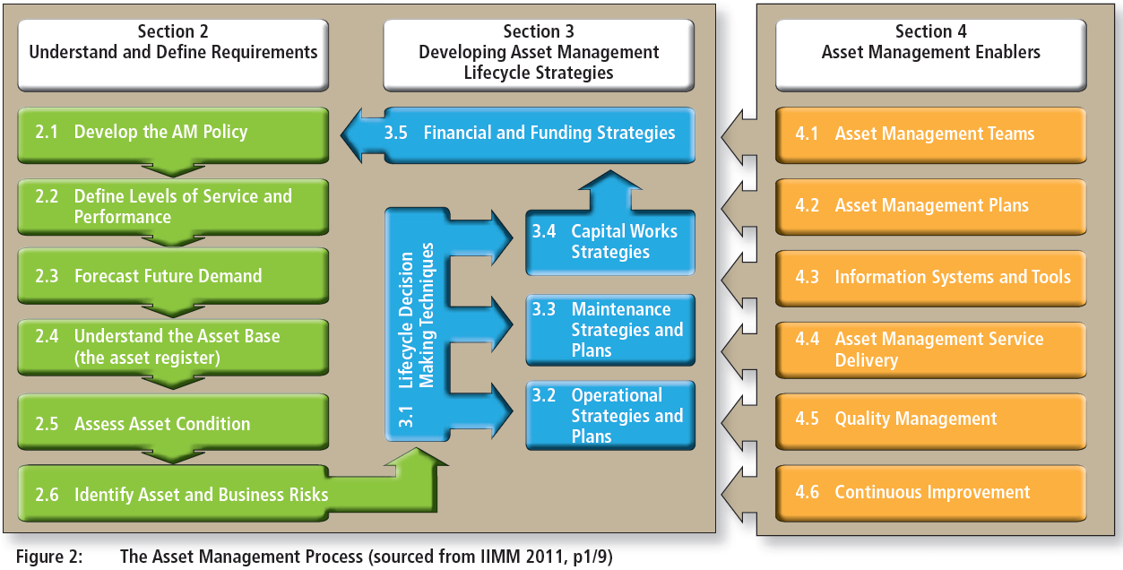
International Infrastructure Management Manual
The International Infrastructure Management Manual is widely accepted as the leading document on Asset Management. The manual provides valuable guidance on how to implement good AM practice and includes over 100 case studies demonstrating good practice across a wide range of assets.

Slide 10
International Infrastructure Management Manual
Section 2 of the AM process is about understanding and defining what services the infrastructure assets should deliver.
This Section will help to answer the questions:
• What are my required levels of service and performance delivery?
• How will demand for these change over time?
• What is the current state of my assets?
• Are they capable of meeting these demands now and in the future & what are the risks they may not?

Slide 11
International Infrastructure Management Manual
Section 3 is about understanding and deciding the most effective lifecycle strategies to deliver the defined requirements.
This Section will help to answer the questions:
• What are my best strategies for operating, maintaining,
replacing and improving the assets?
• How much will providing the service cost over the longterm?
• What is my best long-term funding strategy?

Slide 12
International Infrastructure Management Manual
Section 4 provides guidance on the AM ‘enablers’ that support effective infrastructure planning and decision processes described above.
This includes the structures, capabilities, plans, systems, tools and external resources the organisation needs for effective AM.
It also details an approach for ensuring AM practices are subject to continuous improvement.

Slide 13
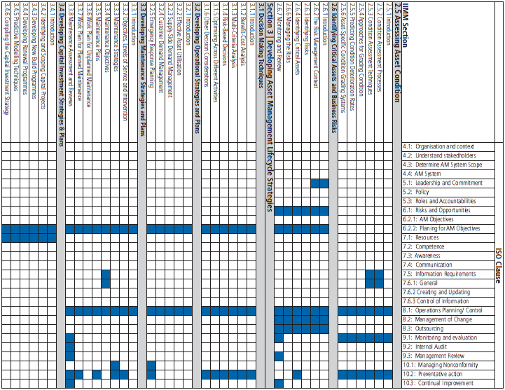
IIMM vs ISO

Slide 14
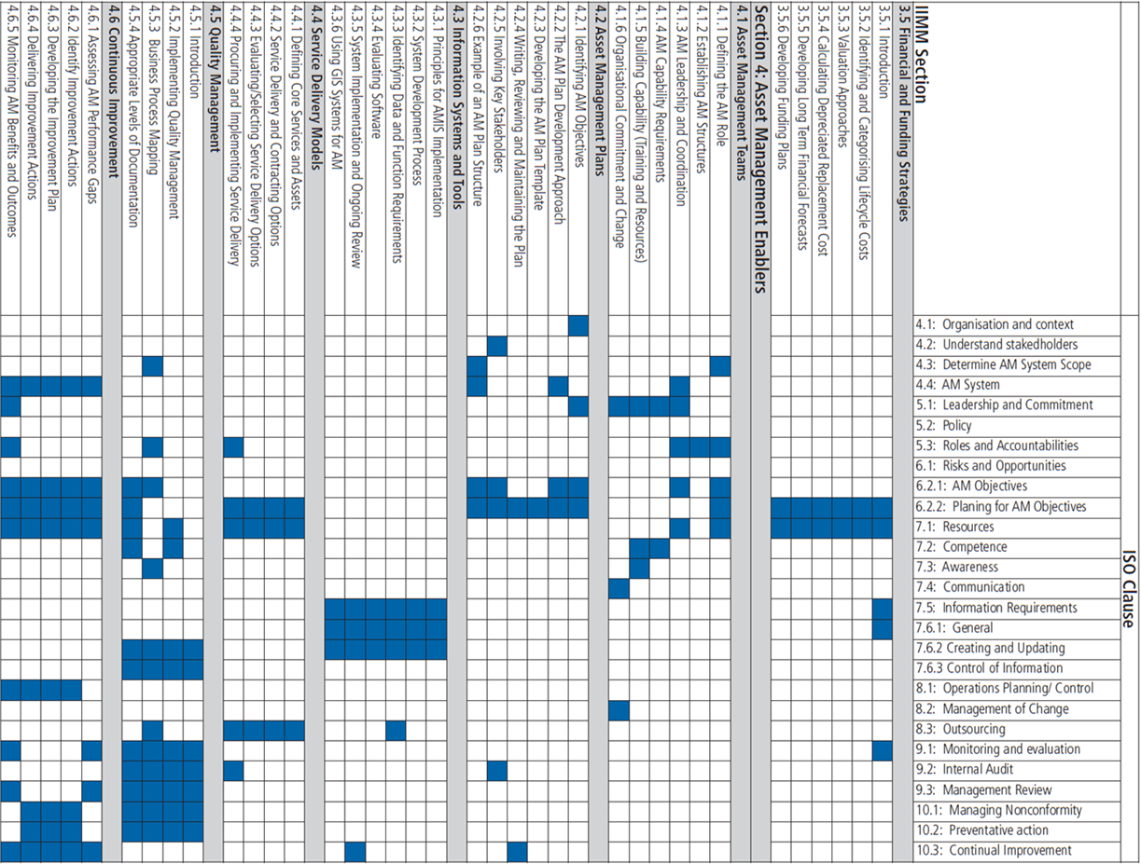
IIMM vs ISO (Cont.)

Slide 15
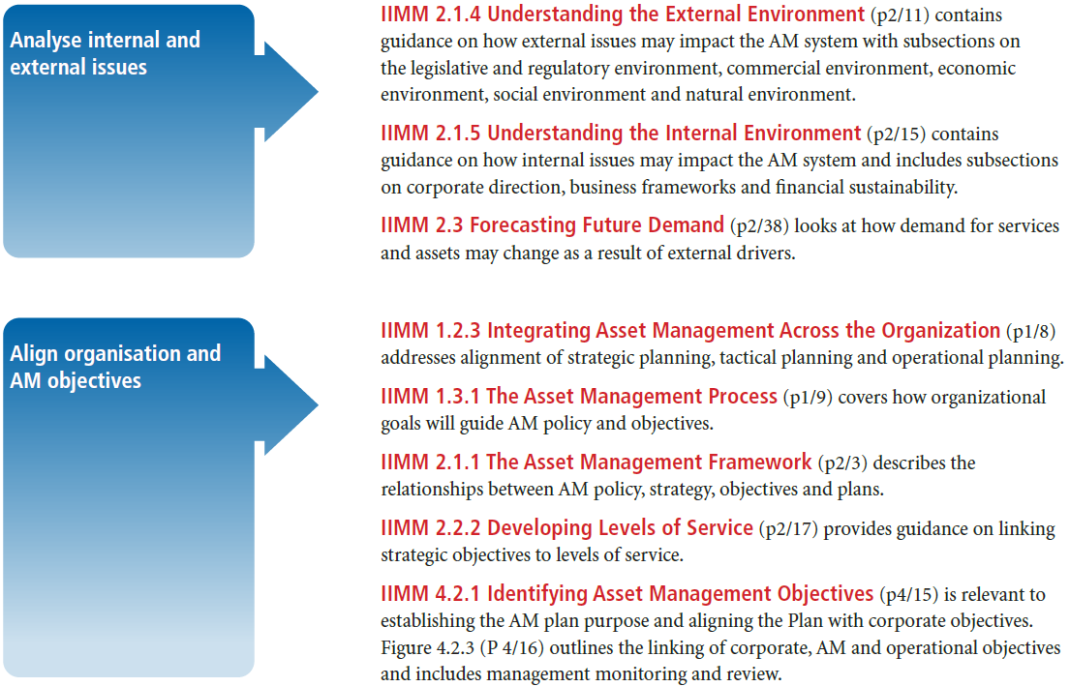
ISO 4 – Context of Organisation 4.1: Understand the Organisation and Its Context
This ISO section addresses the need to explore all issues (internal and external) potentially impacting on the organisational objectives and how to translate these into AM objectives, via a Strategic Asset Management Plan (SAMP).

Slide 16
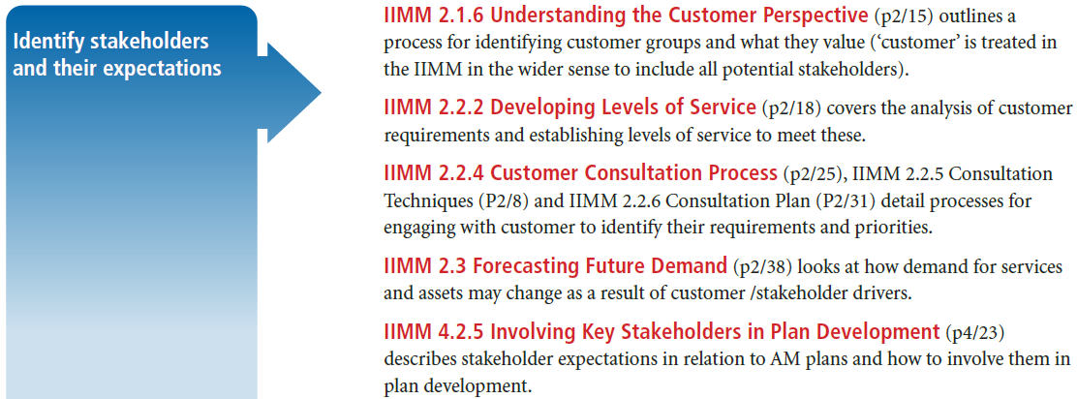
4.2: Understand the Needs and Expectations of Stakeholders
This ISO section deals with identifying stakeholder relevant to the AM system and their needs and expectations.

Slide 17
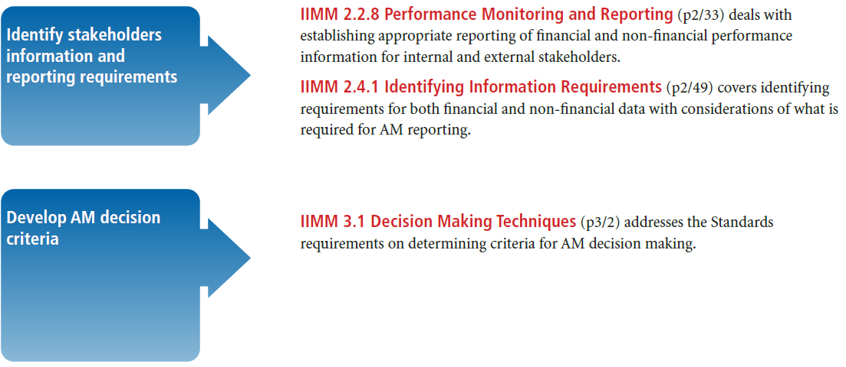
4.2: Understand the Needs and Expectations of Stakeholders (Cont.)

Slide 18
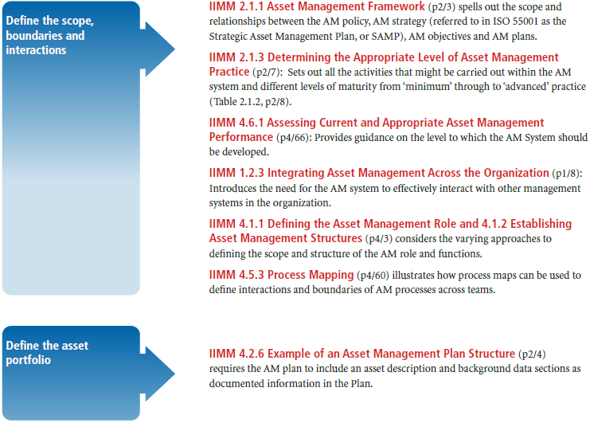
4.3: Determine the Scope of the Asset Management
This ISO section deals with determining the boundaries and applicability of the AM system and possible interaction with other systems/processes.

Slide 19
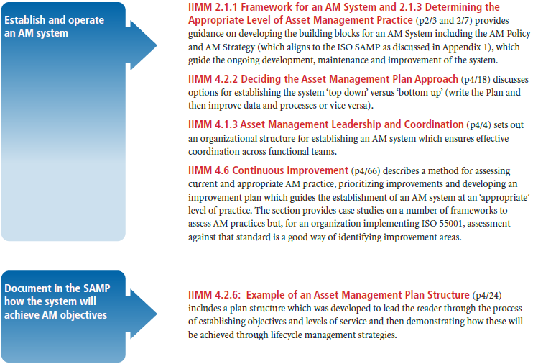
4.4: Determine the Scope of the Asset Management
This ISO section deals with the process for establishing and operating an AM system.

Slide 20
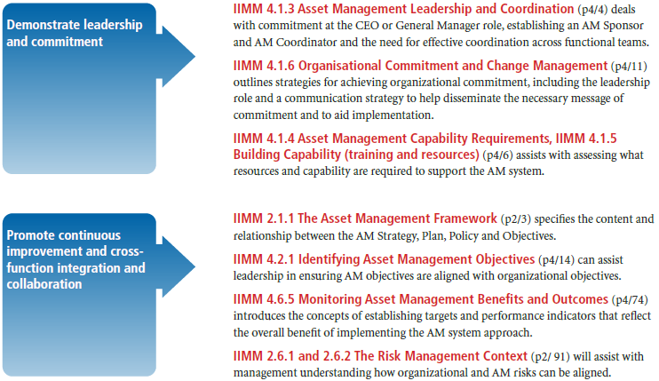
ISO 5 - Leadership 5.1: Leadership and Commitment
This ISO section requires top management to demonstrate leadership and commitment with respect to the AM system. There are a number of criteria specified that need to be met to demonstrate this leadership and commitment, including; resourcing the AM system, communicating the importance of AM, cross-functional collaboration, continual improvement and risk management.

Slide 21
5.2: Policy
This ISO section deals with the requirements for top management to establish an AM policy. There are a number of criteria specified that need to be met when formulating such Policy. These include ensuring appropriateness, commitment, consistency, communication, availability and review.

Slide 22
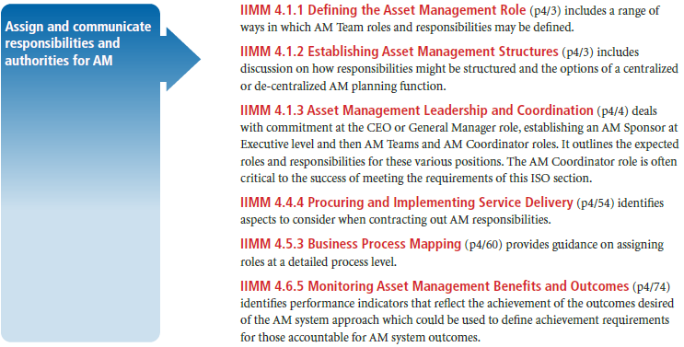
5.3: Organisational Roles, Responsibilities and Authorities
This ISO section deals with the obligation for top management to ensure that the responsibilities and authorities for relevant roles are assigned and communicated within the organisation. There are a number of criteria that have to be met by top management to demonstrate this.

Slide 23
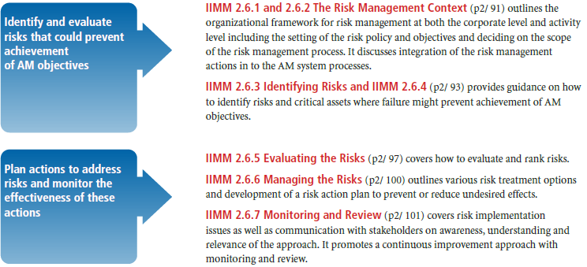
ISO 6 - Planning 6.1: Actions to address Risks & Opportunities
This ISO section deals with addressing the risks and opportunities that need to be considered
when planning for the AM system to achieve its intended objectives and outcomes, and how
they might change with time.

Slide 24
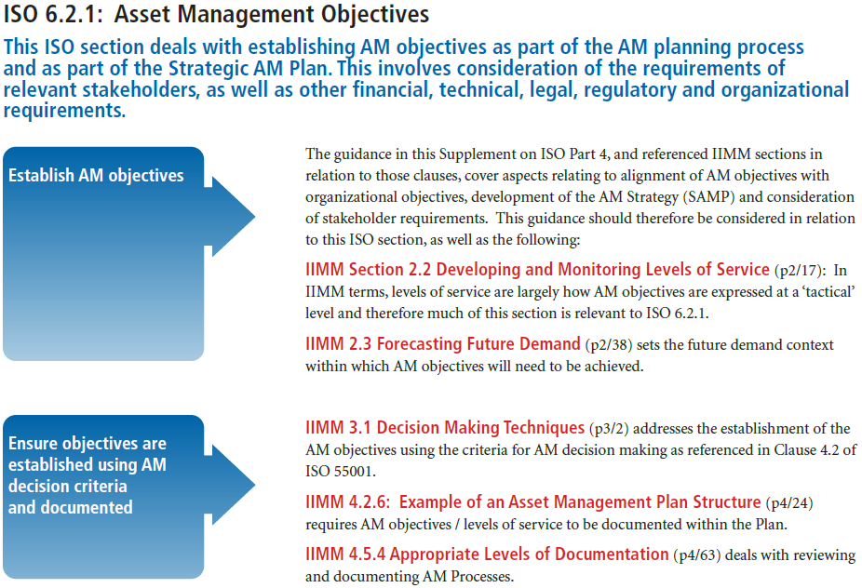
6.2: AM Objectives and Planning to achieve them

Slide 25
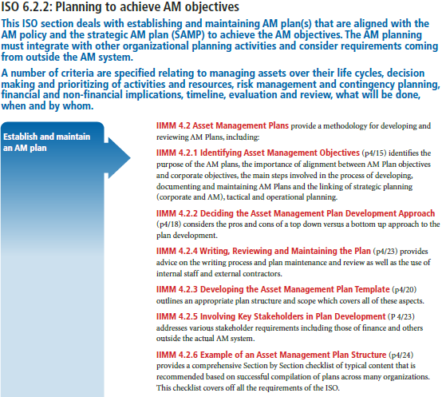
6.2: AM Objectives and Planning to achieve them

Slide 26
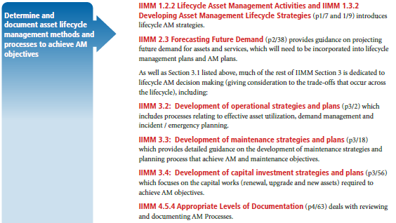
6.2: AM Objectives and Planning to achieve them (6.2.2 Cont.)

Slide 27
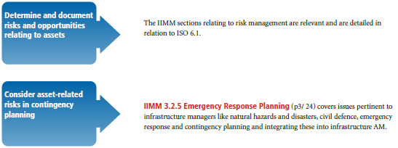
6.2: AM Objectives and Planning to achieve them (6.2.2 Cont.)

Slide 28
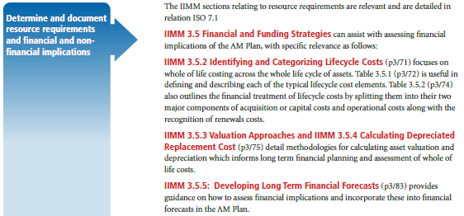
6.2: AM Objectives and Planning to achieve them (6.2.2 Cont.)

Slide 29
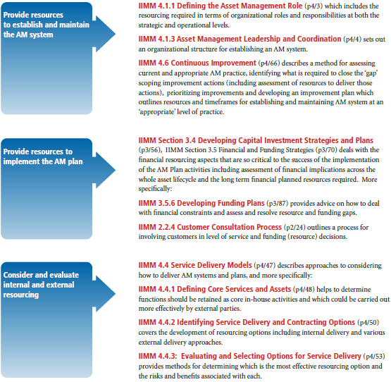
ISO 7 - Support 7.1: Resources
This ISO section deals with providing the necessary resources for the establishment,
implementation, maintenance and continual improvement of the AM system and for
implementing the activities specified in the AM plan(s).

Slide 30
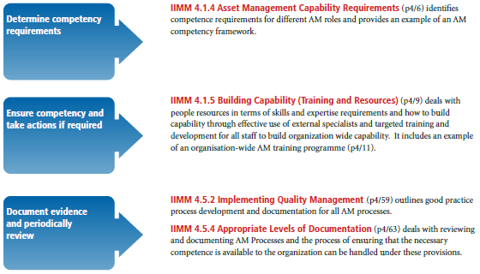
7.2: Competence
This ISO section covers the necessary competence (based on education, training or experience)
of person(s) doing work that could affect the performance of assets, AM or AM System. It looks at acquiring the necessary competence, evaluating action taken, reviewing current and future needs and documenting evidence of this.

Slide 31
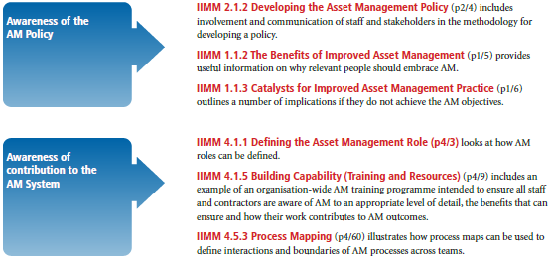
7.3: Awareness
This ISO section deals with ensuring awareness by all who can impact the AM objectives. There are a number of criteria specified which address specific awareness of issues like the AM policy, work activities including associated risks and how these benefit effectiveness, and performance and implications of not meeting the AM System requirements.

Slide 32
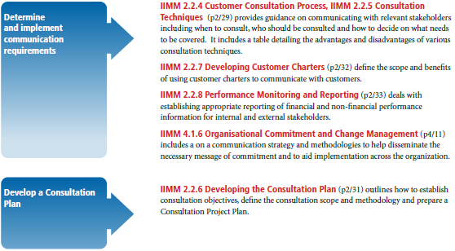
7.4: Communication
This ISO section deals with internal and external communications relevant to assets, AM and the AM system. It includes the what, when, who and how of communication.

Slide 33
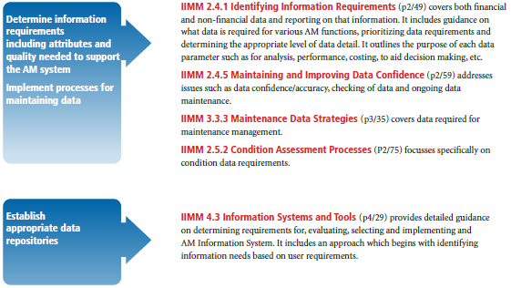
7.5: Information requirements
This ISO section deals with the information requirements across all elements of AM. There are a number of criteria specified which address risks, AM roles, responsibilities, processes, activities and information exchange and impacts on decision making.

Slide 34
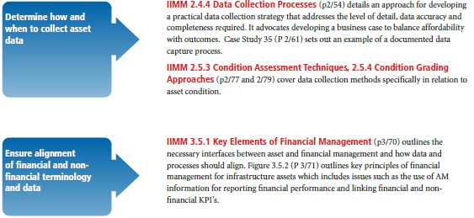
7.5: Information requirements (Cont.)

Slide 35
7.6: Documented Information 7.6.1 General
This ISO section deals with documented information as part of the AM system which includes that required by this International Standard, that applicable for legal and regulatory requirements and that deemed necessary from Section 7.5.

Slide 36
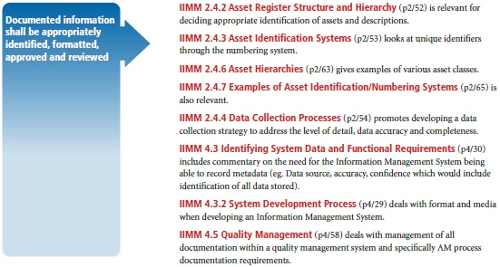
7.6: Documented Information 7.6.2 Creating and Updating
This ISO section deals with creating and updating documented information.

Slide 37
7.6: Documented Information 7.6.3 Control of documented information
This ISO section deals with the control of documented information required by the AM system
and by this International Standard, to ensure it is adequately protected and available for use. There are a number of criteria specified which address amongst other things, access, retrieval, storage and preservation. Relevant external documented information shall also be appropriately identified and controlled.

Slide 38
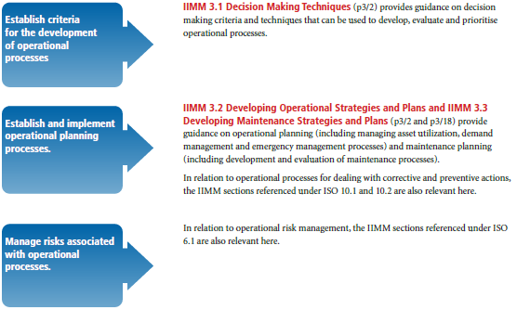
ISO 8 - Operation 8.1: Operational Planning and Control
This ISO section deals with the processes needed to implement the planning actions determined earlier and corrective and preventive actions determined in 10.1 and 10.2. There are a number of criteria specified which address the required processes and keeping documented information.

Slide 39
8.2: Management of change
This ISO section deals with prior assessment and management of any risks associated with any planned change that could impact on achieving the AM objectives.

Slide 40
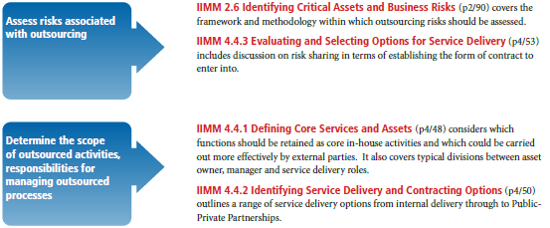
8.3: Outsourcing
This ISO section deals with assessing risk and controlling any outsourced processes or activities
that can impact on the achievement of AM objectives to ensure they integrate into the organisation’s AM system. There are a number of criteria specified which address scoping the outsourced processes/activities and their interfaces with the organisation’s own processes/activities.

Slide 41
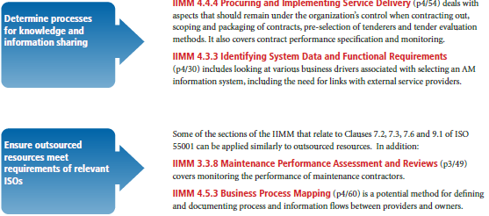
8.3: Outsourcing (Cont.)

Slide 42
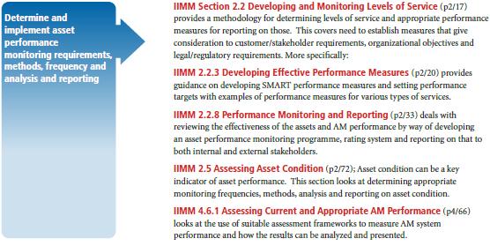
ISO 9 – Performance Evaluation 9.1: Monitoring, Measurement, Analysis and Evaluation
This ISO section deals with what and when to monitor, and measure and report on performance
(including financial and non-financial performance) and the effectiveness of the AM system. There are a number of criteria specified which address effectiveness of the monitoring processes.

Slide 43
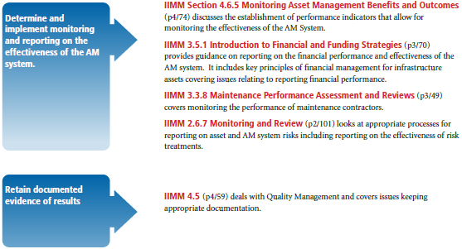
9.1: Monitoring, Measurement, Analysis and Evaluation (Cont.)

Slide 44
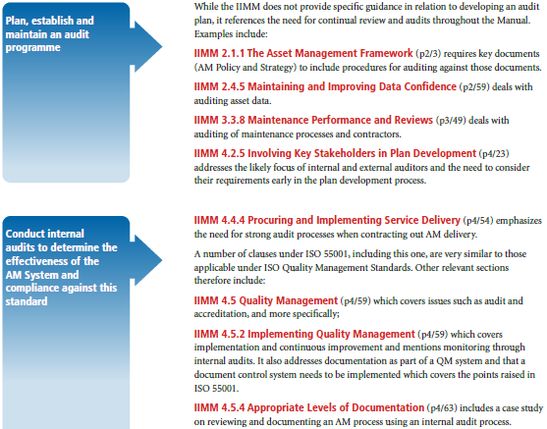
9.2: Internal Audit
These ISO sections 9.2.1 and 9.2.2 deal with conducting internal audits to test conformance, implementation and maintenance of the AM system. There are a number of criteria specified which address a range of issues to be considered when establishing an audit programme(s).

Slide 45
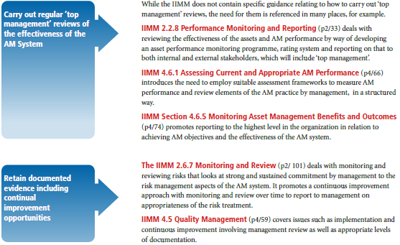
9.3: Management Review
This ISO section deals with top management reviewing the organisation’s AM system to ensure its continuing effectiveness. There are a number of criteria specified which address actions expected to be carried out as part of such management reviews.

Slide 46
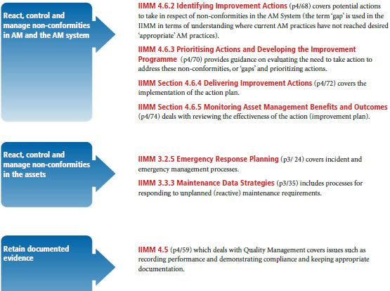
ISO 10 – Improvement 10.1: Nonconformity and corrective action
This ISO section deals with the organisation reacting to any nonconformity or incident and taking action to control and correct it. There are a number of criteria specified which address future occurrences, implementing resultant action, and reviewing effectiveness of such action.

Slide 47
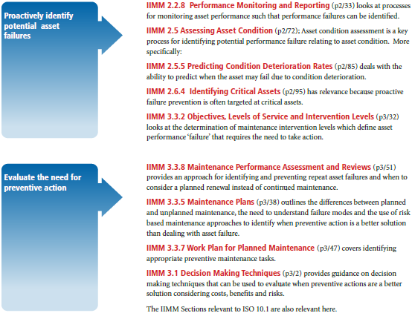
10.2: Preventative Action
This ISO section deals with the processes to proactively identify possible preventive action.

Slide 48
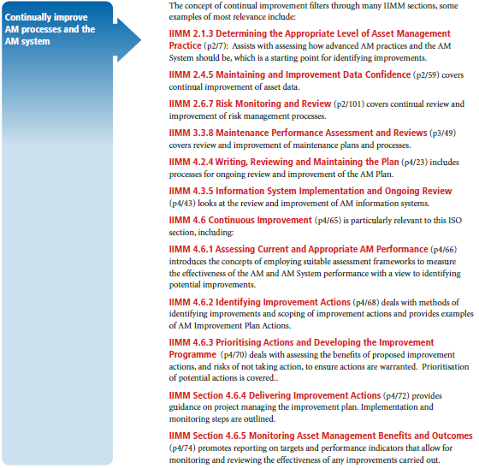
10.3: Continual Improvement
This ISO section deals with continually improving the organisation’s AM and AM system.

Slide 49
Sign-off
Sign documents.
Close the sale.

